Slide 1

Green Pace
Security Policy Presentation
Developer: Eddy Godoy

Slide 2

OVERVIEW: DEFENSE IN DEPTH
The purpose behind these security policies is to establish and maintain a safe and secure environment for us and our users with multi layered defense to prevent any potential attacks.

Slide 3
THREATS MATRIX
Likely: possibility
of happening but with low risk/severity
Priority: possibility of happening with high risk/severity
Low Priority: unlikely to happen and low risk/severity if it does
Unlikely: not much possibility of happening but high risk/severity if it does
Likely STD-002-CPP STD-007-CPP | Priority STD-004-CPP STD-005-CPP
Low priority STD-001-CPP STD-006-CPP | Unlikely STD-003-CPP

Slide 4
10 PRINCIPLES
1. Validate Input Data
2. Heed Compiler Warnings
3. Architect and Design for Security Policies
4. Keep It Simple
5. Default Deny
6. Adhere to the Principle of Least Privilege
7. Sanitize Data Sent to Other Systems
8. Practice Defense in Depth
9. Use Effective Quality Assurance Techniques
10. Adopt a Secure Coding Standard

Slide 5
CODING STANDARDS
STD-004-CPP
STD-005-CPP
STD-003-CPP
STD-002-CPP
STD-007-CPP
STD-001-CPP
STD-006-CPP

Slide 6
ENCRYPTION POLICIES
Encryption at rest
Encryption in flight
Encryption in use

Slide 7
TRIPLE-A POLICIES
Authentication
Authorization
Accounting

Slide 8
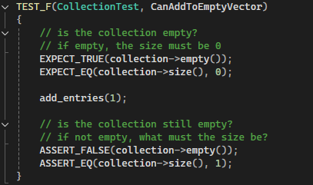
Unit Testing

Slide 9
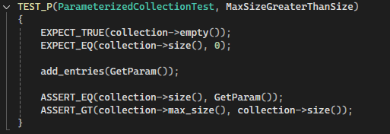

Unit Testing

Slide 10
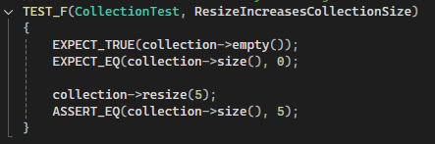
Unit Testing

Slide 11
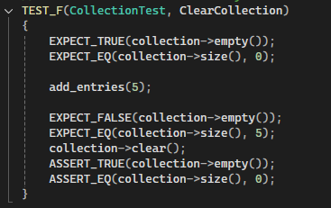
Unit Testing

Slide 12
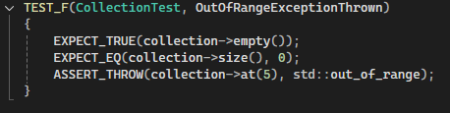
Unit Testing

Slide 13
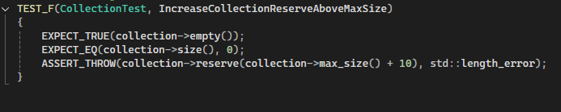
Unit Testing

Slide 14

AUTOMATION SUMMARY

Slide 15
TOOLS
[Explain the DevSecOps pipeline.]
[Summarize the external tools and where and how they are used in the context of the diagram.]

Slide 16
RISKS AND BENEFITS
[Describe the problems, the solutions, and the risks or benefits involved if you act now or wait. Where is the strategy lacking? What are the risks of using this strategy? Which steps should be taken?]

Slide 17
RECOMMENDATIONS
Training plans and practice assigned and required
DevSecOps to be followed

Slide 18
CONCLUSIONS
Security is a must!
Training and practice are essential to success

Slide 19
REFERENCES
Software Engineering Institute. (n.d.). SEI CERT C++ coding standard. Carnegie Mellon University. https://wiki.sei.cmu.edu/confluence/pages/viewpage.action?pageId=88046682

